Slide 1


Study of soft photons yield in pp & pA interactions at U-70 and Nuclotron
E. Kokoulina, V. Nikitin
A. Ciumeică
VBLHEP, JINR
ISP, 7-27 July 2019
University of Bucharest, Faculty of Physics

Slide 2
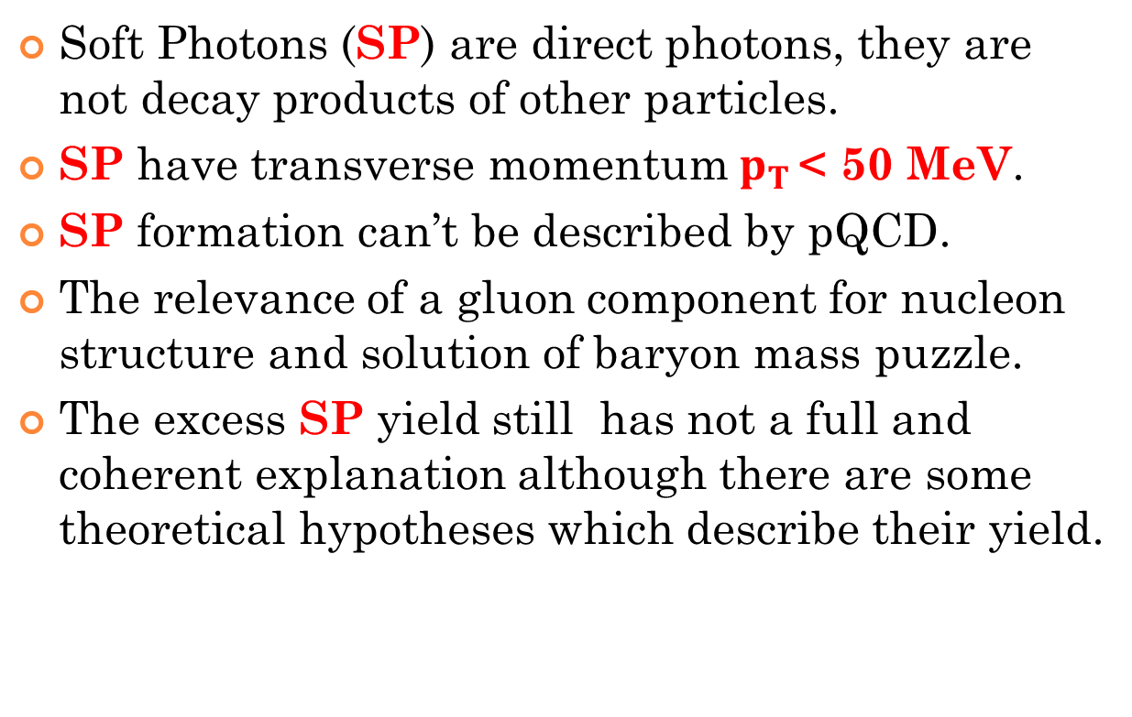
Why Soft Photons?
Soft Photons (SP) are direct photons, they are not decay products of other particles.
SP have transverse momentum${ p}_{T }$< 50 MeV.
SP formation can’t be described by pQCD.
The relevance of a gluon component for nucleon structure and solution of baryon mass puzzle.
The excess SP yield still has not a full and coherent explanation although there are some theoretical hypotheses which describe their yield.

Slide 3

Estimation of SP’s emission region
$→$L ~ 4-6 fm
But hadronization region is estimetd at 1-2 fm.

Slide 4
SP excess in different interactions
BEBC, 1984
solid line –bremsstrahlung
QED
HELIOS, 1989
WA83, 1993
DELPHY
2009
WA91, 2002

Slide 5
Excess of SP yield at Nuclotron
Experimental and MC spectra of energy release in ECal + a pre-shower with 3.5А GeV/с beams of D (left) and Li (right) (50th + 51st runs).
Criterions of selection: 1) E in the front veto-counter < 0.3 MIPs; 2) E in pre-shower 0.5 < E < 4 MIPs; 3) ToF-1200 < t-tγ <600 ps;
4) E of more than 2 MeV is registered in 1 BGO crystal; 5) location
of shower in crystal must overlay throughout vertical with the
triggered pre-shower counter; 6) E deposition in the outer BGO
layer should be ≤ 1/3 of a total to prevent significant leakages.

Slide 6
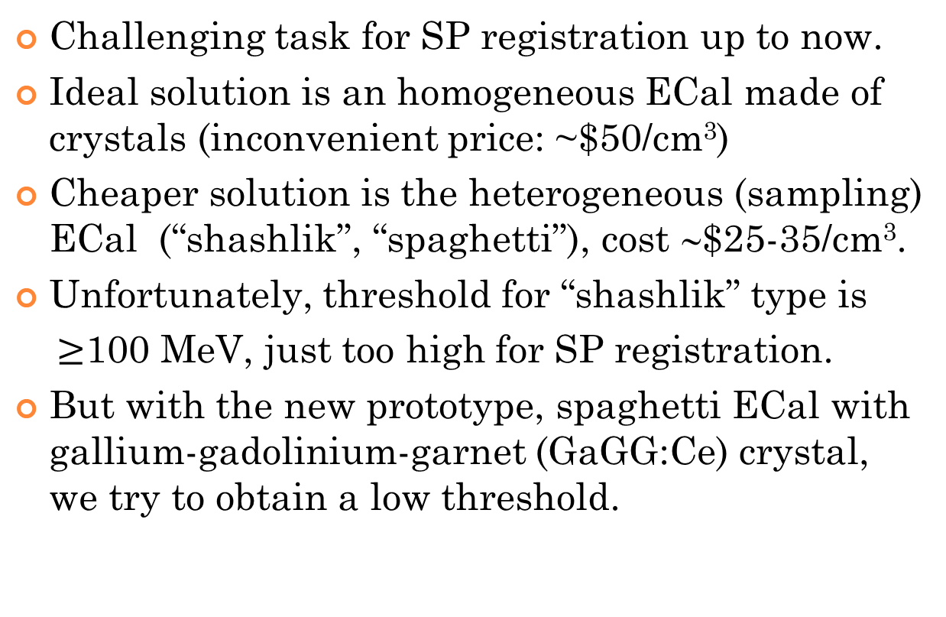
Measurement of Soft Photons
Challenging task for SP registration up to now.
Ideal solution is an homogeneous ECal made of crystals (inconvenient price: ~$50/cm³)
Cheaper solution is the heterogeneous (sampling) ECal (“shashlik”, “spaghetti”), cost ∼$25-35/cm³.
Unfortunately, threshold for “shashlik” type is
$≥$100 MeV, just too high for SP registration.
But with the new prototype, spaghetti ECal with gallium-gadolinium-garnet (GaGG:Ce) crystal, we try to obtain a low threshold.

Slide 7
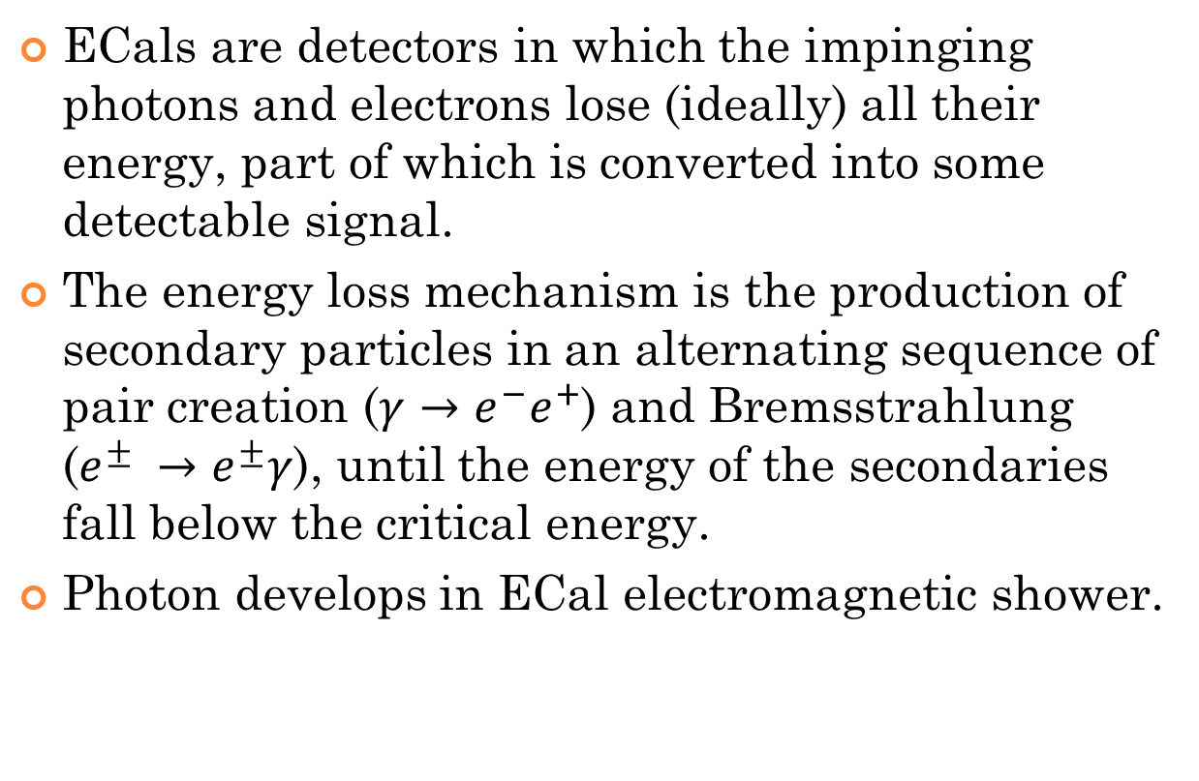
Electromagnetic Calorimeters
ECals are detectors in which the impinging photons and electrons lose (ideally) all their energy, part of which is converted into some detectable signal.
The energy loss mechanism is the production of secondary particles in an alternating sequence of pair creation ($γ→e^{−}e^{+}$) and Bremsstrahlung ($e^{±} →e^{±}γ$), until the energy of the secondaries fall below the critical energy.
Photon develops in ECal electromagnetic shower.

Slide 8
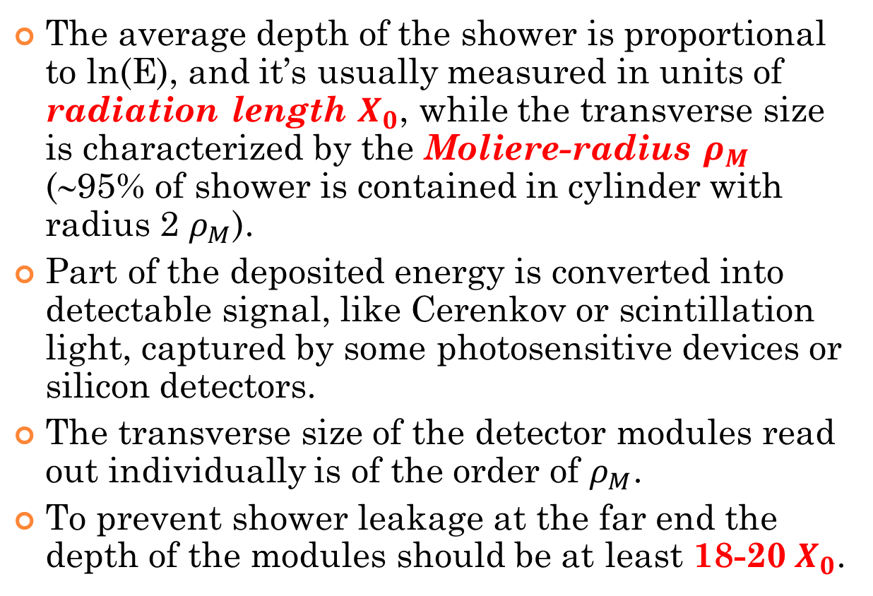
More about ECals
The average depth of the shower is proportional to ln(E), and it’s usually measured in units of radiation length $X_{0}$, while the transverse size is characterized by the Moliere-radius $ρ_{M}$ (∼95% of shower is contained in cylinder with radius 2 $ρ_{M}$).
Part of the deposited energy is converted into detectable signal, like Cerenkov or scintillation light, captured by some photosensitive devices or silicon detectors.
The transverse size of the detector modules read out individually is of the order of $ρ_{M}$.
To prevent shower leakage at the far end the depth of the modules should be at least 18-20${ X}_{0}$.

Slide 9
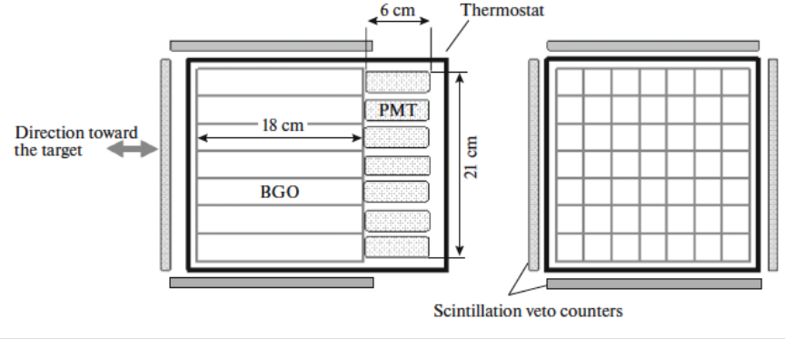
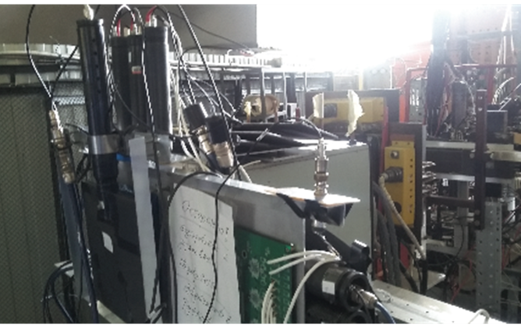
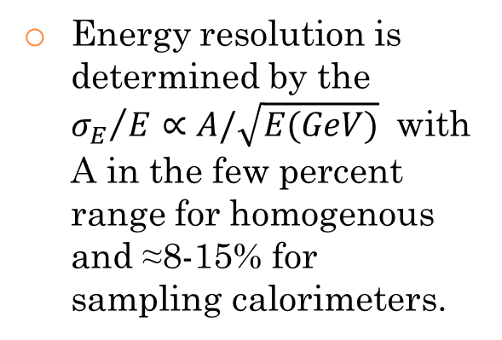
Homogenous ECal
Energy resolution is determined by the ${σ_{E}}/E∝A/\sqrt{E(GeV)}$ with A in the few percent range for homogenous and ≈8-15% for sampling calorimeters.
Crystal ${Bi}_{4}{Ge}_{3}O_{12}$ (small radiation lenght $X_{0}=1.12 cm$)
Photon reconstruction in ECals involves identifying showers (clusters in the raw data) that are likely coming from photons, rejecting hadrons.

Slide 10
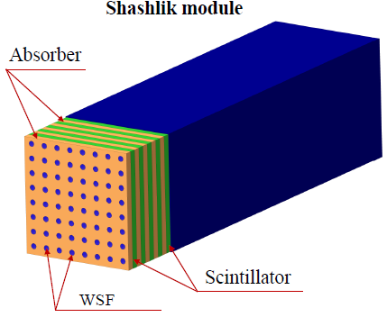
Sampling Ecal – Shashlik
The main problem –non radiation hard scintillator and light guides made from plastic.

Slide 11
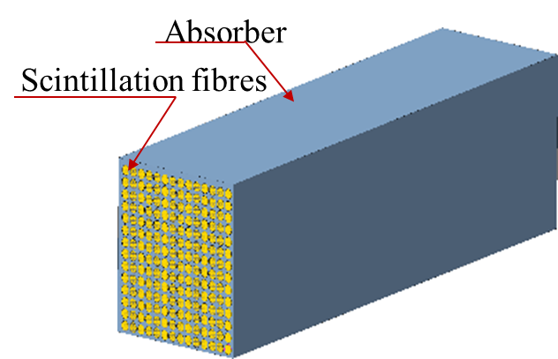
Sampling Ecal – Spaghetti (SpaCal)
SpaCal technology is a type of the sampling calorimeter with scintillation fibers running along shower direction.
The prototype of the detector cell is an assembly of W+Cu composite plates and GAGG: Ce (Gadolinium Aluminium Gallium Garnet, Gd₃Al₂Ga₃O₁₂, doped with cerium) rods.
Granularity of module is defined by the granularity of read-out system.
Energy resolution (ER) strongly depends on the fiber-to-fiber distance!
Expectation of ER: < 10%/E +1%
SpaCal module

Slide 12
SpaCal assembling
Covering of detector cell
GaGG:Ce rods
Cell in assembling
λ =365 nm
Configuration: size of module is 210 x 180 x 400 mm, square fibers with side 1 mm, distance between fibers is 1.8 mm, scintillator GAGG: Ce, absorber Tungsten (75%) Copper (25%) alloy.

Slide 13



Monte Carlo Simulations (GEANT4)
25 MeV, 1 $γ$ particle
50 MeV, 100 $γ$ particles
25 MeV, 10 $γ$ particles

Slide 14
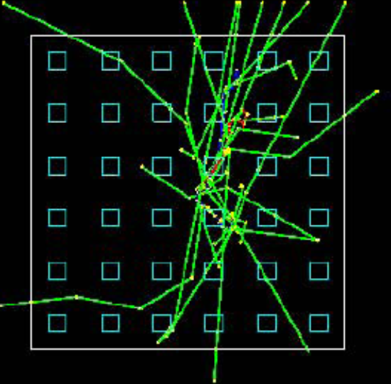
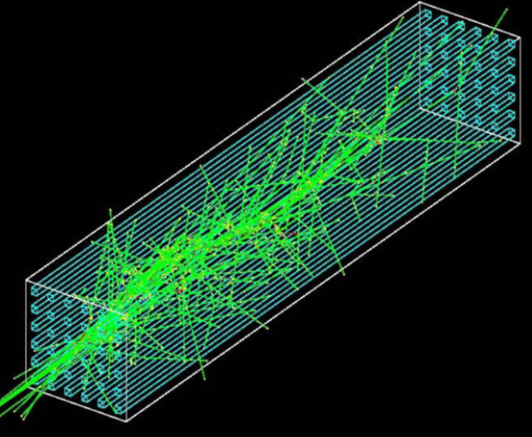


Monte Carlo Simulations (GEANT4)
100 MeV, 1 $γ$ particle
100 MeV, 10 $γ$ particles

Slide 15
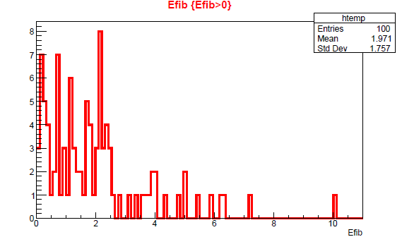
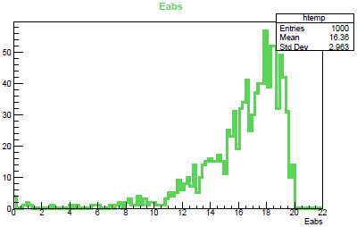
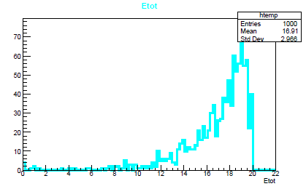
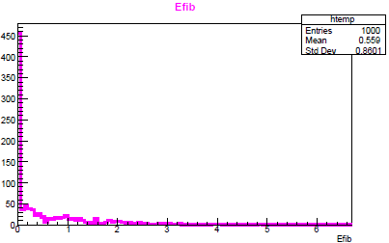
ROOT: data processing
50 MeV, 100 γ particles
20 MeV, 1000 γ particles
20 MeV, 1000 γ particles
20 MeV, 1000 γ particles

Slide 16
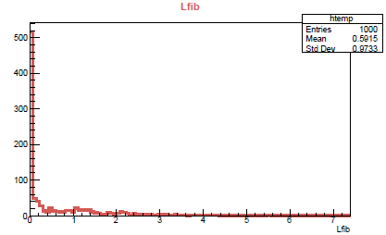
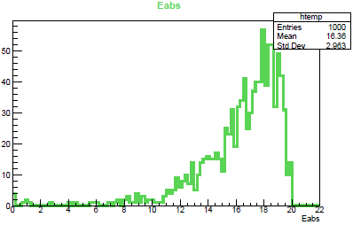
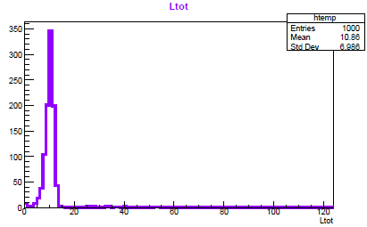
ROOT: data processing
20 MeV, 1000 γ particles

Slide 17
Results and future plans
ER will be better than 10% for photons with energy above 5 MeV with SiPMs and the correct scheme for transporting of light to a photo detector.
Parameters of assembly can be improved by changing of the cross section of the crystal rods, adjusting the absorber density and optimizing the length of SpaCal for a certain energy range of the detected gamma quanta.
It is planned to continue studying of SP yield at Nuclotron and U-70 for registration their at interactions of light and heavy ions and proton beams on fixed targets.
Also the project team prepare program of SP study at NICA accelerator complex with heavy ions.

Slide 18
Conclusions
These three weeks working at the project show me the physical programme of SP study is unique and very promising.
Simulations of SpaCal are the evidence this programme is quite reasonable and feasible.
I think the SP study can lead us to a major breakthrough.

